Slide 1

The jamming transition as a paradigm to understand the loss landscape of deep neural networks
Shahak Nir Ajwan Khoury

Slide 2
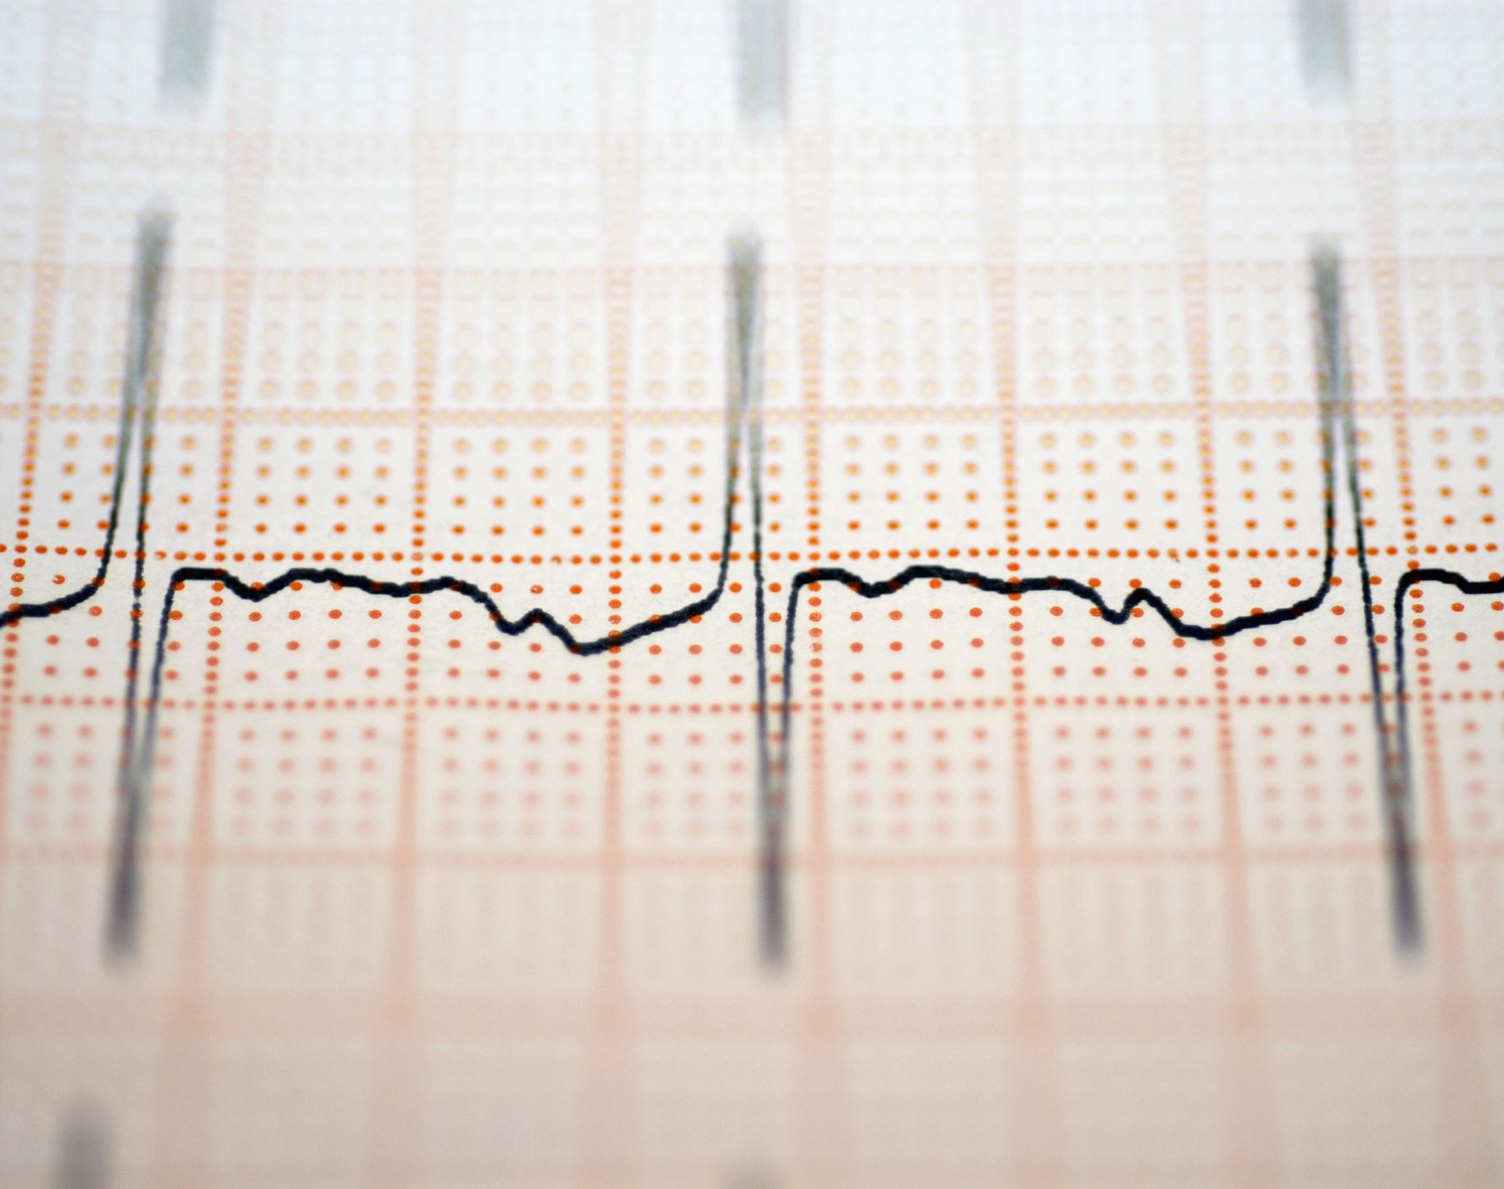
The Loss Function
What will we learn?
Understanding under which conditions neural networks do not get stuck in poor minima of the loss function.
How the landscape of the loss evolves as depth is increased.
∆Quantity – which characterizes how well (∆<0) or badly (∆>0) a datum.
What do we actually do?
Here we predict and test empirically, an analogy between this landscape and the energy landscape of repulsive ellipses.
Our analysis give us a simple explanation : why poor minima of the loss function can not be encountered in the overparametrized regime

Slide 3

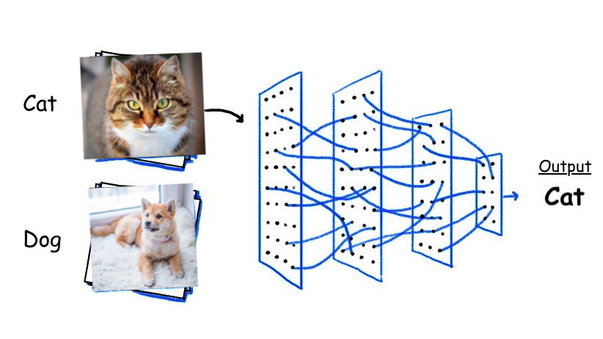
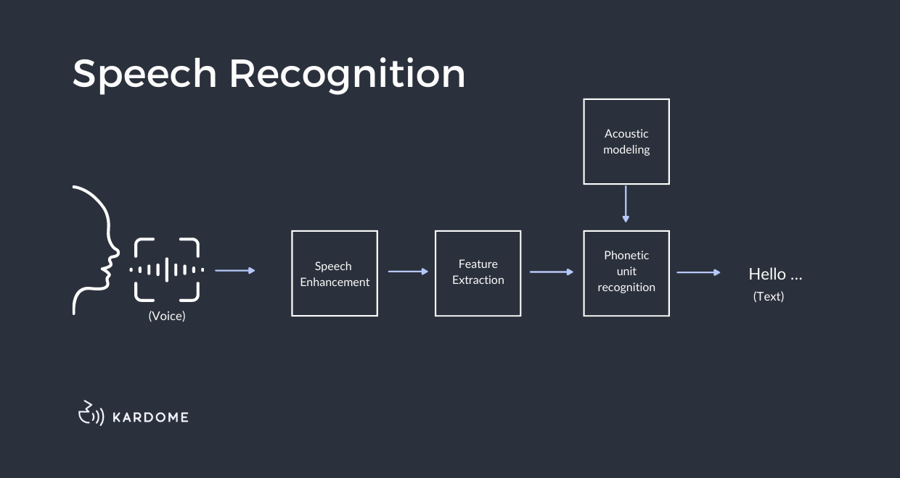
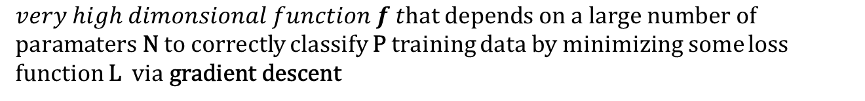
Deep Neural Networks
$very high dimonsional function f t\text{hat} \text{depends} \text{on} \text{a} \text{large} \text{number} \text{of} \text{paramaters} \text{N}$to correctly classify P training data by minimizing some loss function L $\text{via} \text{gradient} \text{descent}$

Slide 4
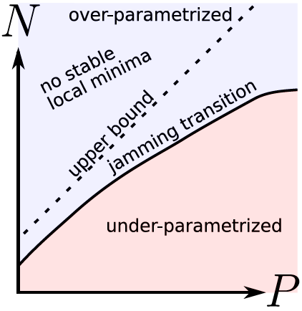
Loss Functions And Fully Connected Deep Networks Undergo A Jamming Transition.
By changing the loss function from cross-entropy to hinge we simplify the problem and distinct over and under parametrize problems.
N: degrees of freedom, P: training examples.

Slide 5
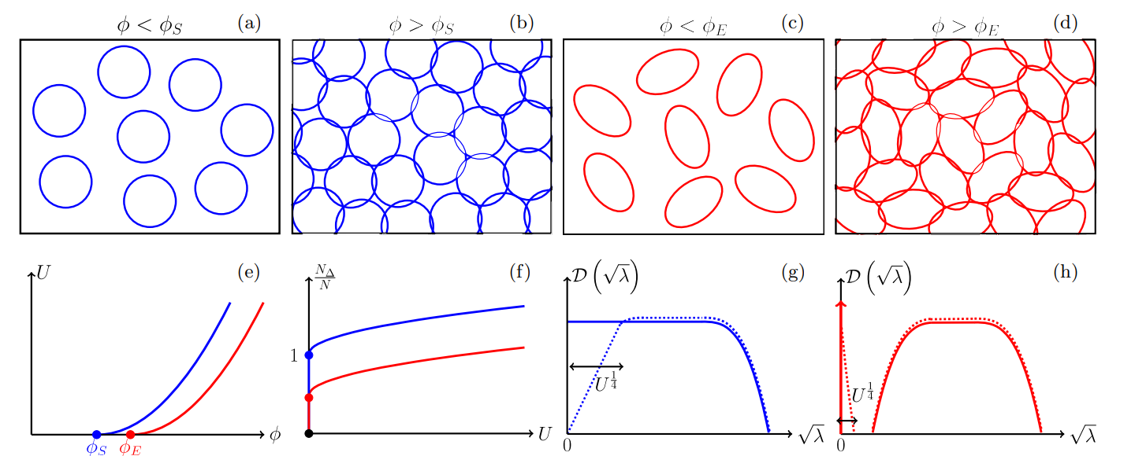
ANALOGY BETWEEN JAMMING AND DEEP LEARNING
A- JAMMING
φS for spheres φE for ellipses
Sketch of the jamming transition for repulsive spheres and ellipses.

Slide 6
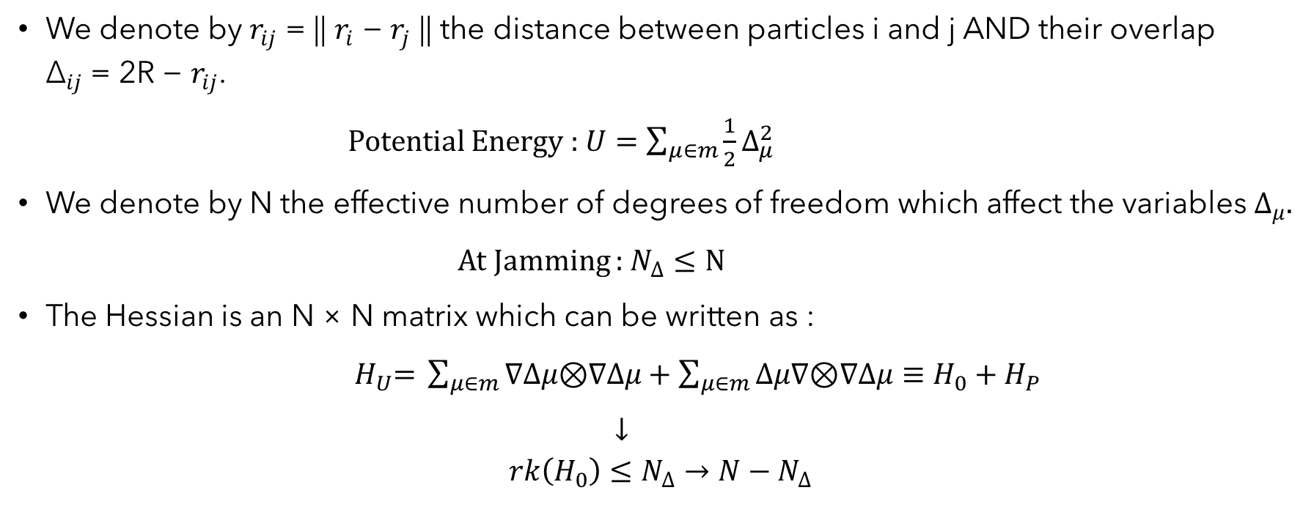
SPHERICAL PARTICLES
We denote by $r_{ij}$ = || $r_{i}$ − $r_{j}$ || the distance between particles i and j AND their overlap ${\text{∆}}_{ij}$ = 2R − $r_{ij}$.
Potential Energy : $U=\sum_{μ∈m}{\frac{1}{2}∆_{μ}^{2}}$
We denote by N the effective number of degrees of freedom which affect the variables $∆_{μ}.$
At Jamming : $N_{∆}≤N$
The Hessian is an N × N matrix which can be written as :
$H_{U}\text{= }\sum_{μ∈m}{∇∆μ\text{⊗}∇∆μ}+\sum_{μ∈m}{∆μ∇\text{⊗}∇∆μ}≡H_{0}+H_{P}$
$↓$ $$rk\left(H_{0}\right)≤N_{∆}→N−N_{∆}$$

Slide 7
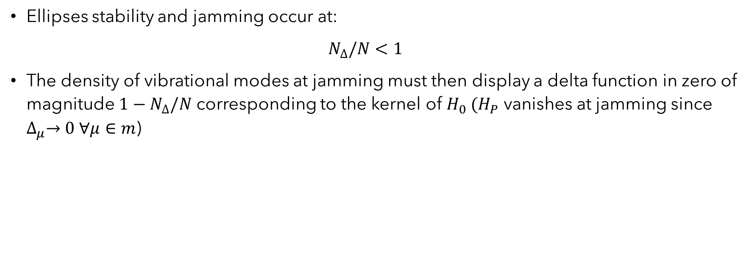
ELLIPSES PARTICLES
Ellipses stability and jamming occur at:
$N_{∆}/N<1$
The density of vibrational modes at jamming must then display a delta function in zero of magnitude $1−N_{∆}/N$ corresponding to the kernel of $H_{0} (H_{P}$ vanishes at jamming since $∆_{μ}→0 ∀μ∈m$)

Slide 8
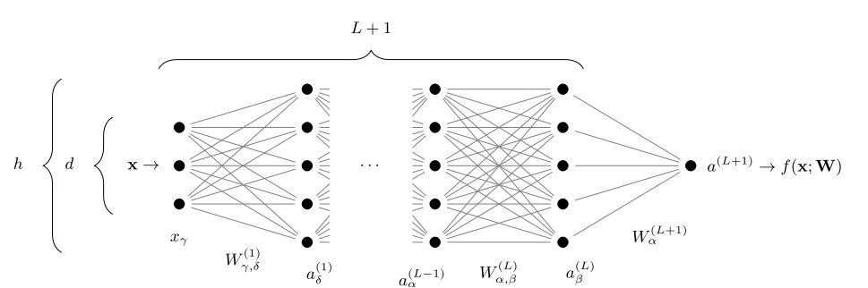
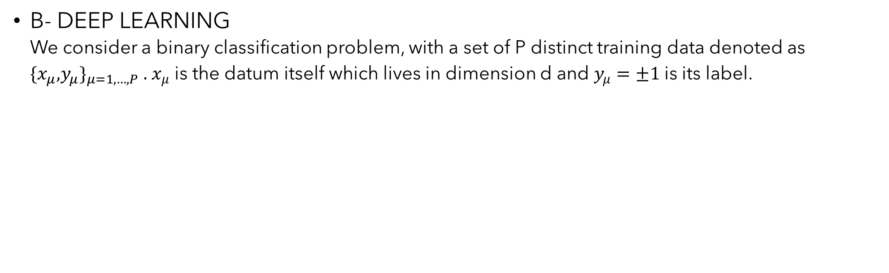
ANALOGY BETWEEN JAMMING AND DEEP LEARNING
B- DEEP LEARNING We consider a binary classification problem, with a set of P distinct training data denoted as ${\text{\{}x_{μ}\text{,}y_{μ}\text{\}}}_{μ=1,…,P}$ . $x_{μ}$ is the datum itself which lives in dimension d and $y_{μ}=±1$is its label.
Architecture of a fully-connected network with L hidden layers of constant size h

Slide 9
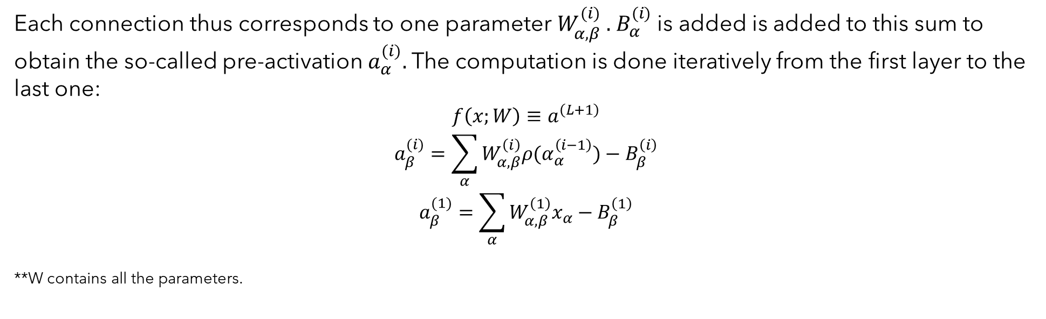
Each connection thus corresponds to one parameter $W_{α,β}^{(i)}$ . $B_{α}^{(i)}$ is added is added to this sum to obtain the so-called pre-activation $a_{α}^{(i)}.$ The computation is done iteratively from the first layer to the last one:
$$f\left(x;W\right)≡a^{\left(L+1\right)}$$
$$a_{β}^{(i)}=\sum_{α}{W_{α,β}^{\left(i\right)}ρ(α_{α}^{\left(i−1\right)})}−B_{β}^{\left(i\right)}$$
$$a_{β}^{(1)}=\sum_{α}{W_{α,β}^{\left(1\right)}x_{α}}−B_{β}^{\left(1\right)}$$ **W contains all the parameters.

Slide 10
Effective Number Of Parameters AND Constraints On The Stability Of Minima
The effective number of degrees of freedom that do affect the output, Neff(W). We denote by Neff(W) the dimension of the tangent space of this manifold at W.
For a fixed number of data P, if N is sufficiently large then gradient descent with proper weights initialization leads to L = 0, whereas if N is very small after training L > 0

Slide 11
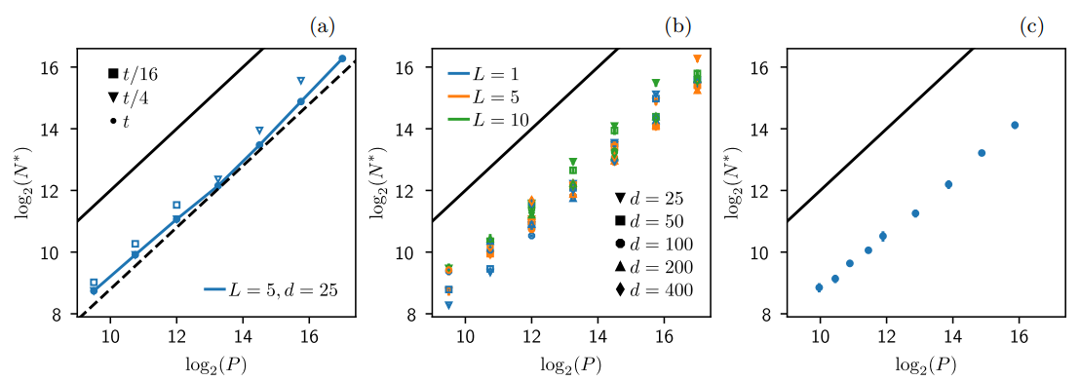
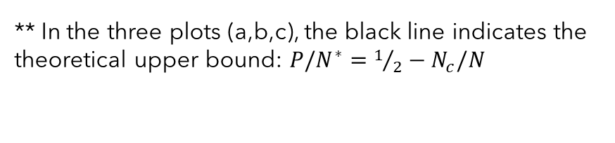
Jamming Transition With Random Data
** In the three plots (a,b,c), the black line indicates the theoretical upper bound: $P/N^{∗}=1/2−N_{c}/N$

Slide 12
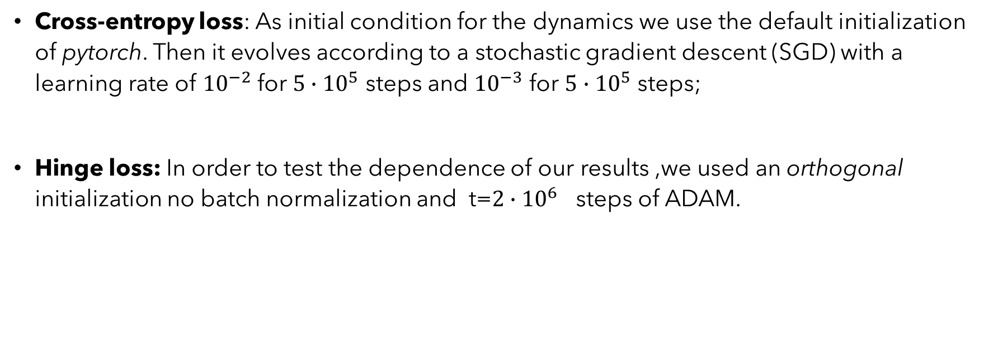
FOR RANDOM DATA THE TRANSITION OCCURS FOR N ∼ P
Cross-entropy loss: As initial condition for the dynamics we use the default initialization of pytorch. Then it evolves according to a stochastic gradient descent (SGD) with a learning rate of ${10}^{−2}$ for $5∙{10}^{5}$ steps and ${10}^{−3}$ for ${5∙10}^{5}$ steps;
Hinge loss: In order to test the dependence of our results ,we used an orthogonal initialization no batch normalization and t=$2∙{10}^{6}$ steps of ADAM.

Slide 13
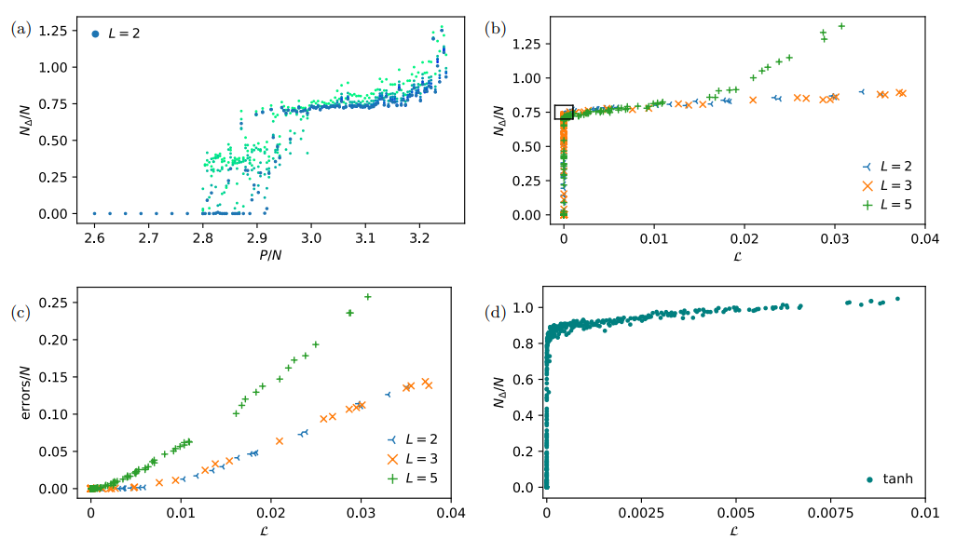
THE TRANSITION IS HYPOSTATIC

Slide 14
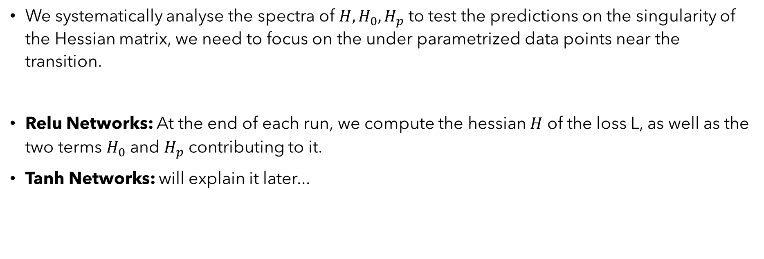
SPECTRUM OF THE HESSIAN OF THE LOSS NEAR JAMMING
We systematically analyse the spectra of $H, H_{0},H_{p}$ to test the predictions on the singularity of the Hessian matrix, we need to focus on the under parametrized data points near the transition.
Relu Networks: At the end of each run, we compute the hessian $H$ of the loss L, as well as the two terms $H_{0}$ and $H_{p}$ contributing to it.
Tanh Networks: will explain it later...

Slide 15
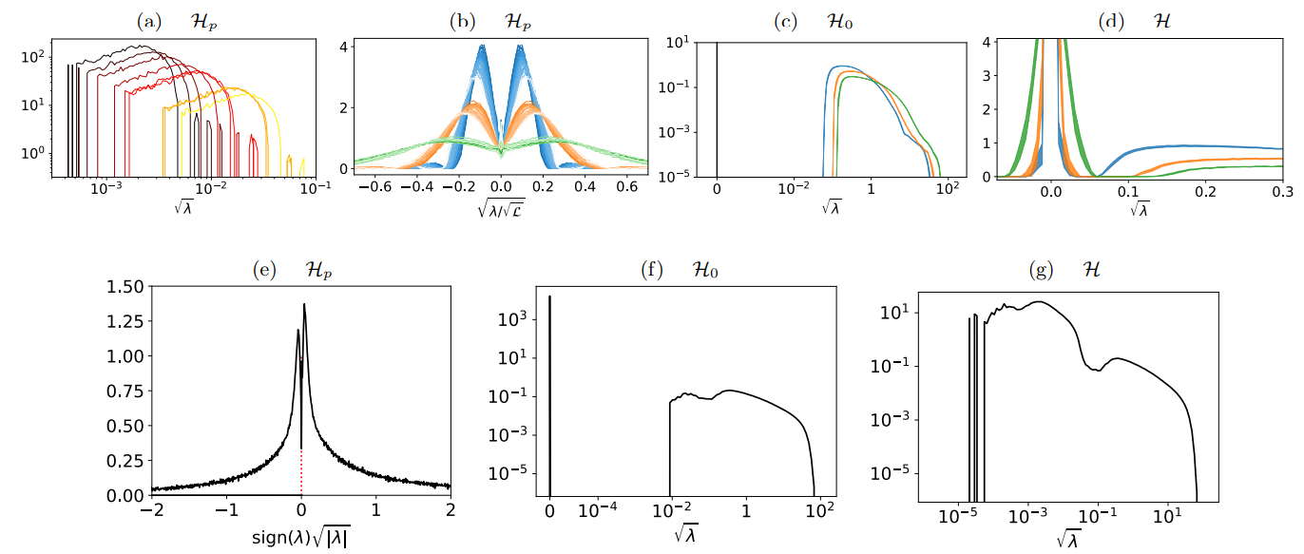
The data shown in this figure concern the under-parametrized points close to the transition for random data.

Slide 16
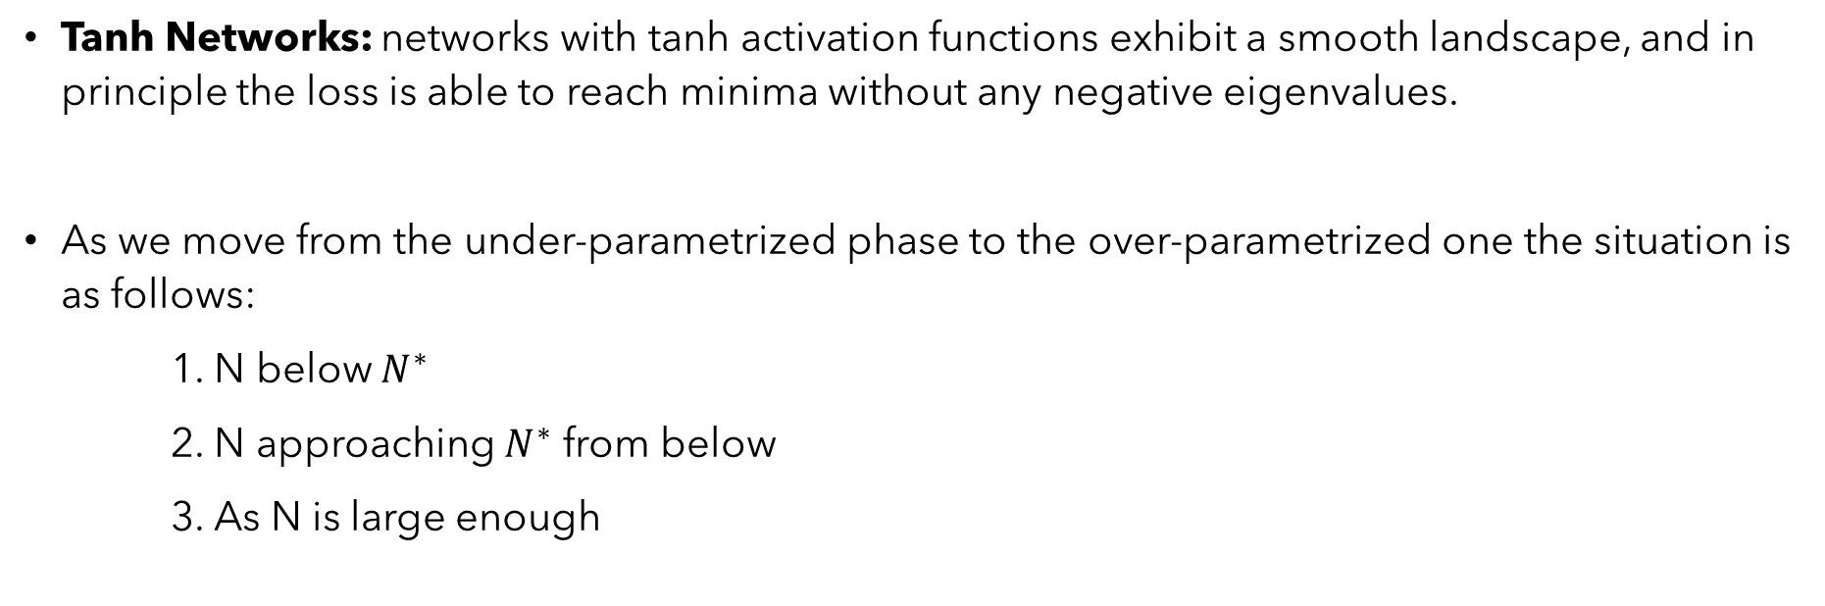
SPECTRUM OF THE HESSIAN OF THE LOSS NEAR JAMMING
Tanh Networks: networks with tanh activation functions exhibit a smooth landscape, and in principle the loss is able to reach minima without any negative eigenvalues.
As we move from the under-parametrized phase to the over-parametrized one the situation is as follows:
1. N below $N^{∗}$
2. N approaching $N^{∗}$ from below
3. As N is large enough

Slide 17
DISTRIBUTION OF GAPS REVEALS NEW SINGULAR BEHAVIOUR
The distribution of gaps ∆ < 0 and overlaps ∆ > 0:
Positive ∆’s are associated with unsatisfied patterns which increase the loss of the system.
Negative ∆’s correspond to satisfied patterns which are correctly classified with a margin and do not contribute to the loss.

Slide 18
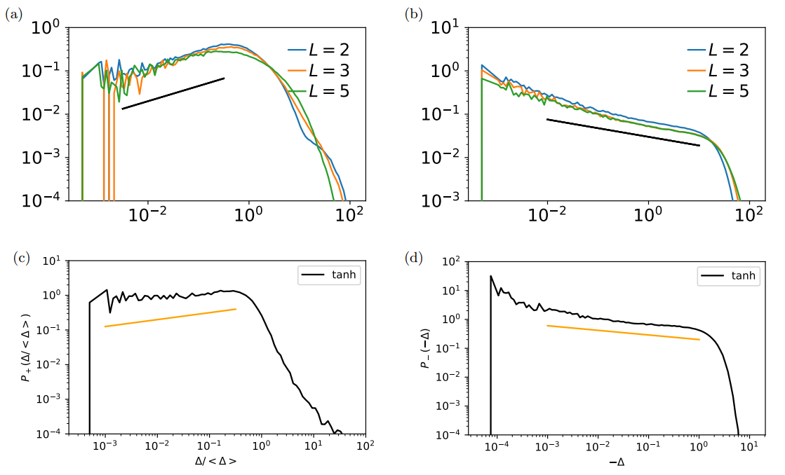
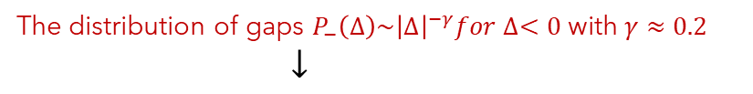
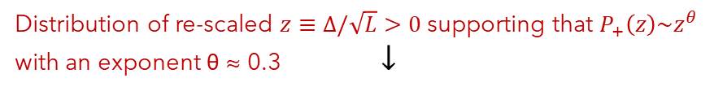
Distribution of re-scaled $z≡∆/\sqrt{L}>0$ supporting that $P_{+}\left(z\right)\sim z^{θ}$ with an exponent θ ≈ 0.3 $↓$
The distribution of gaps $P_{−}\left(∆\right)\sim {\left|∆\right|}^{−γ}for ∆<0$ with $γ≈0.2$
$↓$

Slide 19
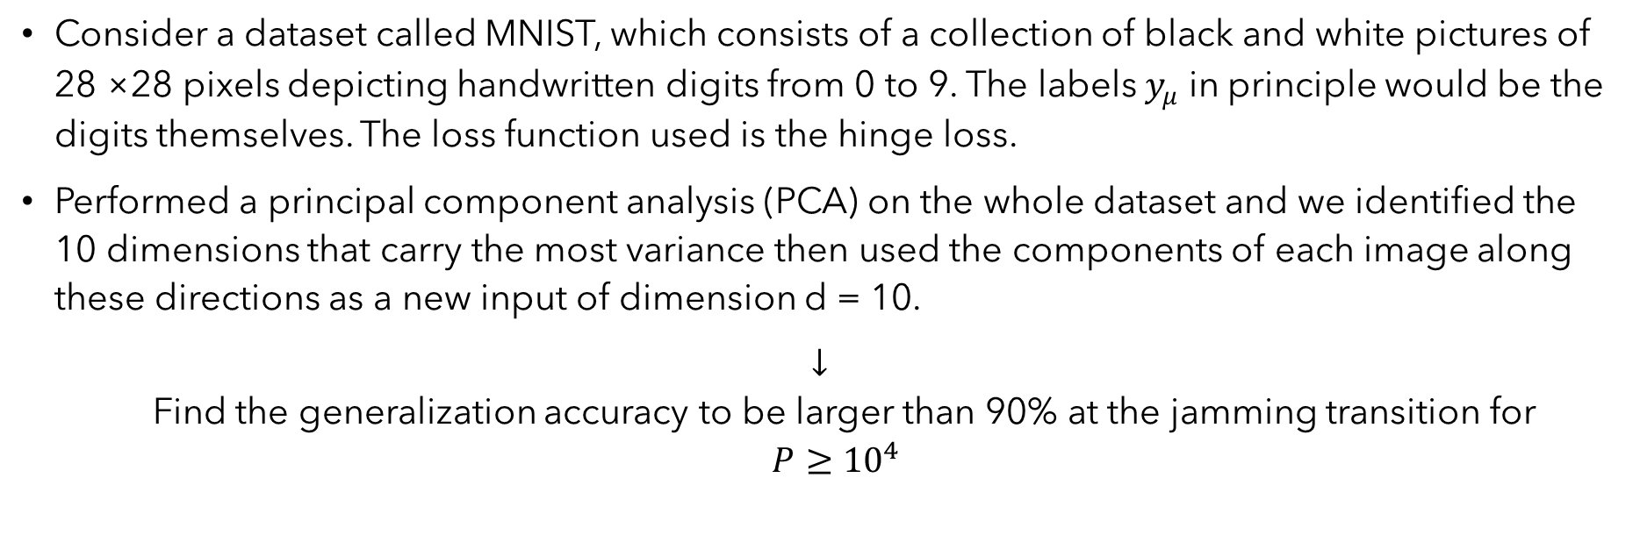
IMAGE DATA: MNIST
Consider a dataset called MNIST, which consists of a collection of black and white pictures of 28 ×28 pixels depicting handwritten digits from 0 to 9. The labels $y_{μ}$ in principle would be the digits themselves. The loss function used is the hinge loss.
Performed a principal component analysis (PCA) on the whole dataset and we identified the 10 dimensions that carry the most variance then used the components of each image along these directions as a new input of dimension d = 10.
$↓$ Find the generalization accuracy to be larger than 90% at the jamming transition for $P≥{10}^{4}$

Slide 20
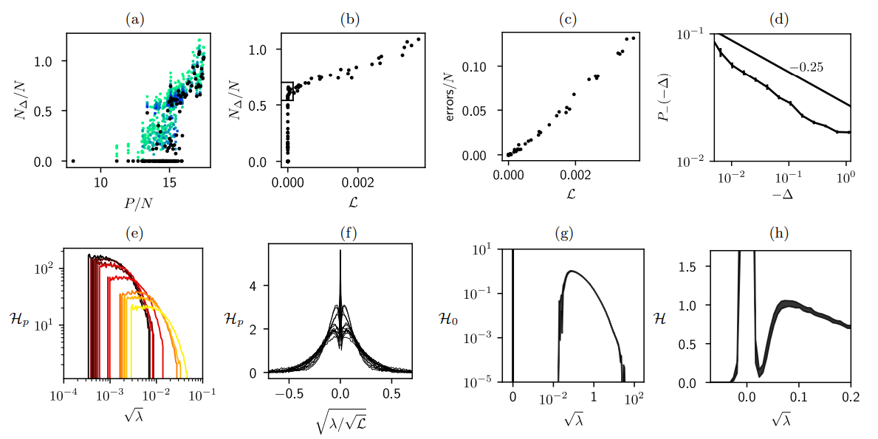
Results with the MNIST dataset, keeping the first 10 PCA components.
$$d=10, h=30, L=5\left(N=3900\right), varying P=1,….,70K$$

Slide 21
CONCLUSION
Not getting stuck in poor minima of the loss
Role of depth
Refence point for network architectures

Slide 22
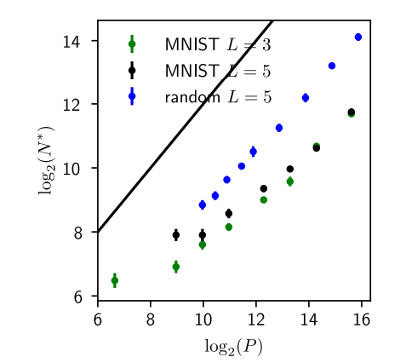
Results with the MNIST dataset, keeping the first 10 PCA components (see main text), with d = 10 and varying P and h.

